Slide 1
BUSQOM 1080: Data Analysis for Business
Fall 2020
Lecture 5 (9/3)
Professor: Michael Hamilton

Slide 2
Lecture Summary
Outline for today:
Topic: Reading Data into R [5-10 Mins]
Topic: More on DataFrames [5-10 Mins]
Topic: Basic Plotting in R [10-15 Mins]
Misc. Course Updates

Slide 3
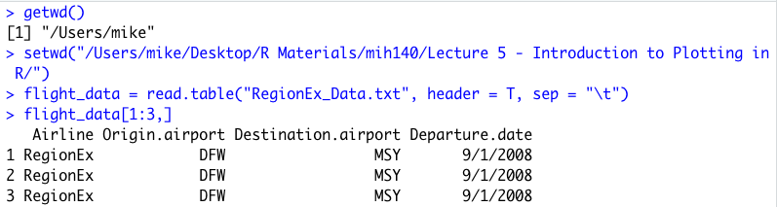
Topic: Reading Data into R
Setting your file path
Your working directory is the files R can currently access (i.e. the data you can access!)
> getwd() # gets your current working directory
> setwd(“file_path”) changes your working directory to the input file path
Reading data into R
> read.table()
> read.csv()
Example (RegionEx_Data.txt can be found in the file folder for Lecture 5!)

Slide 4
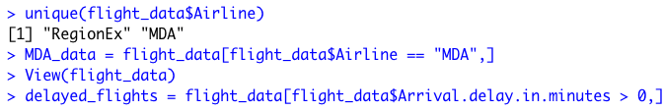
Topic: Accessing DataFrames
Logical Indexing
In DataFrames, a common way to access certain relevant information is using logical indexing i.e. passing a vector of T/F that is T for rows you want to select and false otherwise.
Can do the same thing with the subset function.
Syntax: subset(df, logical_condition, select = c(Columns))
Example:

Slide 5
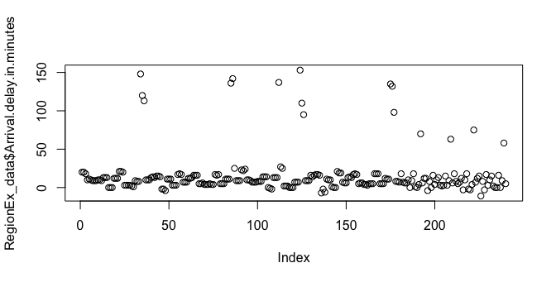
Topic: Basic Plotting in R
The plot() function is a simple and flexible tool for quickly generating plots in R.
> plot(RegionEx_data$Arrival.delay.in.minutes)
We can improve the plot by specifying more features about it
ylab = char, changes the y-axis label
xlab = char, changes the x-axis label
main = char, adds a title above the plot

Slide 6
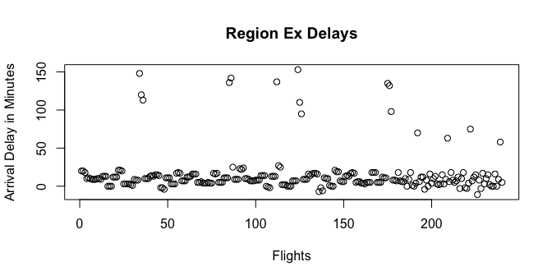
Topic: Basic Plotting in R
The plot() function is a simple and flexible tool for quickly generating plots in R.
> plot(RegionEx_data$Arrival.delay.in.minutes, xlab = ”Flights”, ylab = ”Arrival Delay in Minutes”, main = “Region Ex Delays”)
We can improve the plot by specifying more features about it
pch = num, changes the symbol of the plotted points
col = char, changes the color of the plotted points and/or lines

Slide 7
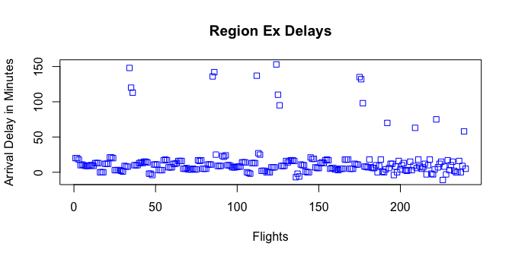
Topic: Basic Plotting in R
The plot() function is a simple and flexible tool for quickly generating plots in R.
> plot(RegionEx_data$Arrival.delay.in.minutes, xlab = ”Flights”, ylab = ”Arrival Delay in Minutes”, main = “Region Ex Delays”, pch = 0, col = “blue”)
Lots of other parameters to explore!

Slide 8
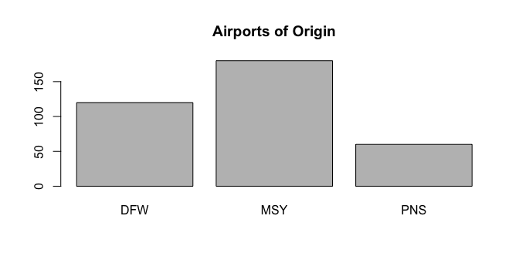
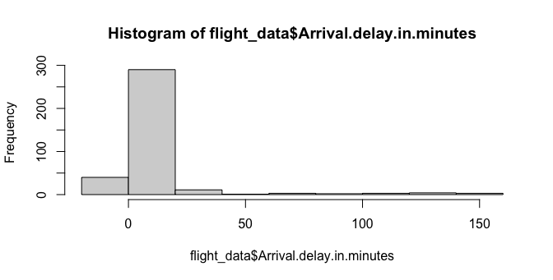
Topic: Special Plotting Functions
To make barcharts, try calling plot() on categorical vector (also known as factor data! Make factors by calling as.factor() )
Example: plot(as.factor(flight_data$Origin.airport), main = "Airports of Origin")
To make histograms try using the function hist() on numeric data
Example: hist(flight_data$Arrival.delay.in.minutes)

Slide 9
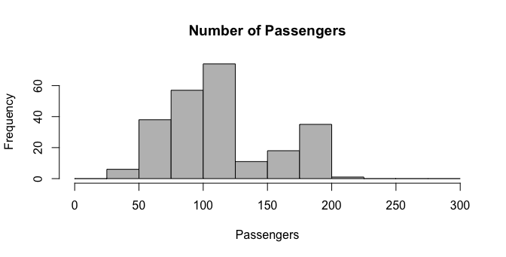
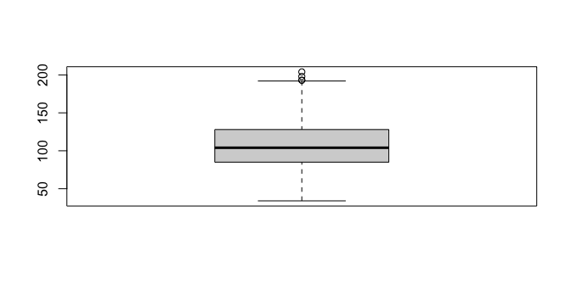
Topic: Special Plotting Functions
We can make better histograms by calling their internal parameters
Example:
hist(flight_data$Number.of.passengers, breaks = seq(0, 300, 25), col = "grey", xlab = "Passengers", main = "Number of Passengers")
We can also make boxplots!
A box plot shows the quantiles and outliers
Example:
boxplot(flight_data$Number.of.passengers)

Slide 10
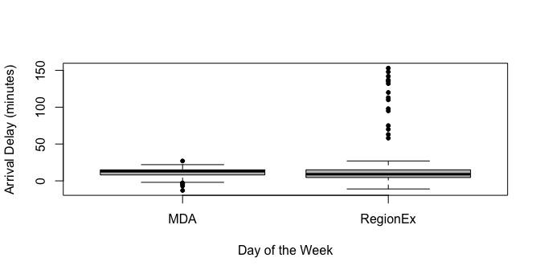
Topic: Special Plotting Functions
Multiple BoxPlots! We can “factor” numeric data with the command: numeric_vector ~ categorical_data
Example:
boxplot(Arrival.delay.in.minutes ~ Airline, data = flight_data, col = "grey", pch = 20, xlab = "Day of the Week", ylab = "Arrival Delay (minutes)")

Slide 11
For Next Time
In the zoom session we will analyze our first dataset together and make some more beautiful plots!
Assignment 2 is due on Friday!
Assignment 3 is due the Friday after (9/11)
Assignment 4 will be posted this weekend, due (9/18)
Thanks! Have a nice weekend!

